Slide 1
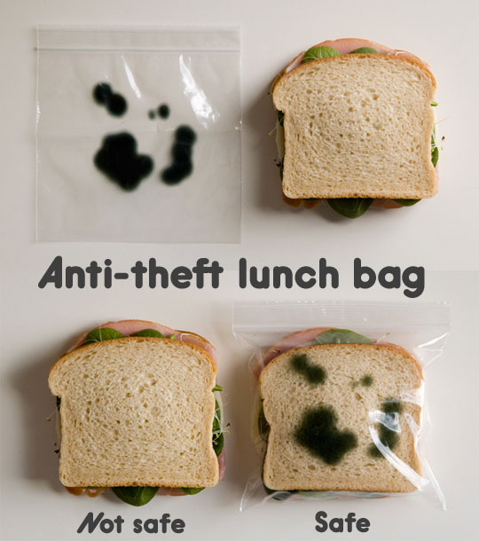
Lunch & Learn

Slide 2
Agenda
Adopting Test First Development
Unit Testing
Test Driven Development
Behaviour Driven Development
Tools: Inifinitest, JBehave
Code Quality with SonarQube

Slide 3
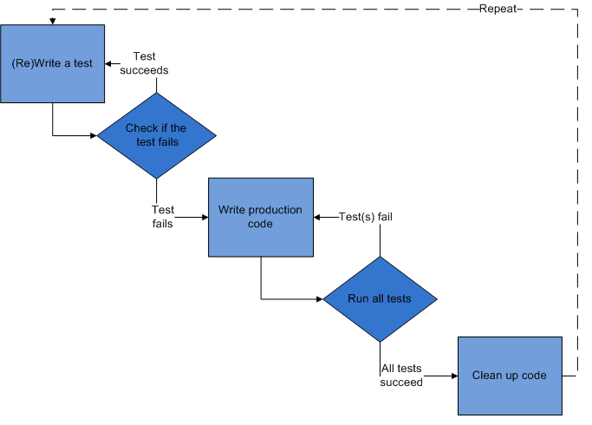
TDD – Test Driven Development
TDD = Refactoring + TFD (Test First Design)

Slide 4
TDD …
development technique where you must first write a test that fails before you write new functional code
does not replace traditional testing, instead it defines a proven way to ensure effective unit testing
tests are like little design documents, little coding examples, that describe how the system works and how to use it
drive the design of a program: one must imagine how the functionality is used by clients, programmer is concerned with the interface before the implementation

Slide 5
BDD
Forget about Tests; Think about Specifications
Forget about Units; Think about Behaviors
specifies that tests of any unit of software should be specified in terms of the desired behavior of the unit
"desired behavior" in this case consists of the requirements set by the business — that is, the desired behavior that has business value

Slide 6
Code Quality
Architecture & Design
Complexity
Tests
Duplications
Potential bugs
Coding rules
Documentation / Comments

Slide 7
Summary
Evolution of testing: Unit to BDD
Tools to speed up & support testing
Code Quality: Sonar Qube

Slide 8
References
TDD & BDD
http://www.agiledata.org/essays/tdd.html
http://en.wikipedia.org/wiki/Test-driven_development
http://butunclebob.com/ArticleS.UncleBob.TheThreeRulesOfTdd
https://www.scrum.org/About/All-Articles/articleType/ArticleView/articleId/642/Adopting-Test-First-Development
http://en.wikipedia.org/wiki/Behavior-driven_development
Sonar Qube
http://www.sonarqube.org/
http://nemo.sonarqube.org/
Practices of an Agile Developer
http://it-ebooks.info/book/44/ -

Slide 9
Thank You

